Slide 1



Spotting Online News: A Mixed Method Study of Online News Engagement and Perceptions on Misinformation
Interventions
2025, October 22
Khatiwada, P., Halko, L., Syed, N., Mahesh, A., Alvanpour, A., & Mauriello, M. (2025). Spotting online news: A mixed-method study of online news engagement and perceptions on misinformation interventions. In Proceedings of the ACM on Human-Computer Interaction (CSCW ’25). ACM.

Slide 2
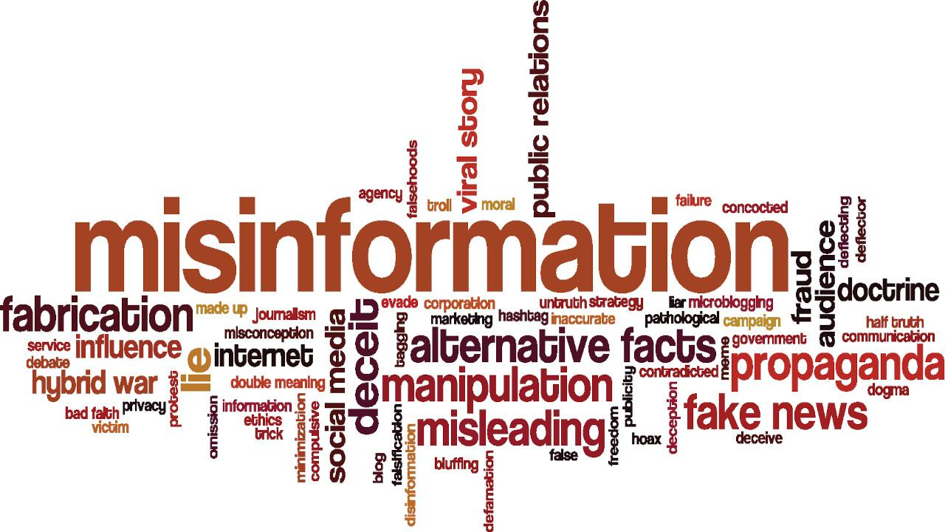
Contents
Motivation and Background
Research Questions
Key Findings
Design Implications
Insights, Limitations and Future Work
Notes:
This is the overview and content I’ll be following
Dont say…. starting with the motivation and background, and wrapping up with the key insights and limitations.”

Slide 3
Contents
Motivation and Background
2.
Research Questions
3.
Methodology
4.
Key Findings
5.
Design Implications
6.
Insights, Limitations and Future Work
Notes:
I’ll go over motivation briefly and real quick to set the stage for the rest of the talk.”

Slide 4
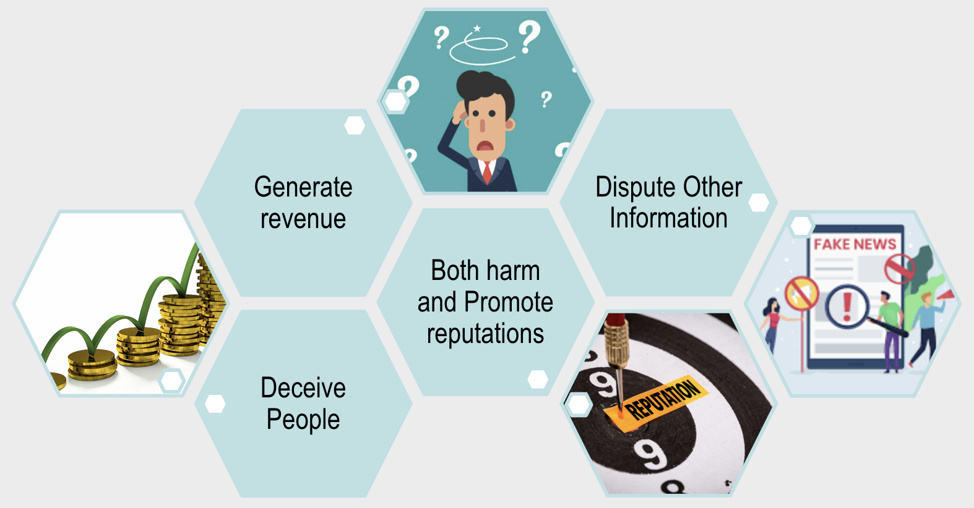

Motivation and Background
Problem 1:
Rampant exposure to misinformation: Over 70% of adults regularly encounter false information on social media.
In the U.S., 59% say misinformation skews their understanding of current events (Pew Research Center, 2021).
Notes:
Research has shown that Over 70% of adults regularly encounter false information on social media.
In the U.S., 59% say misinformation skews their understanding of current events (Pew Research Center, 2021).
The rise of online news platforms has made information more accessible than ever…
But this access comes with a challenge — separating accurate reporting from false or misleading content.
Another example, a Pew Research Center survey found that about one-third of U.S. adults often encounter made-up political news online, and about half report seeing at least somewhat inaccurate news.
Even more concerning, 82% of those who encounter such content believe it causes serious confusion about basic facts of current events.
Repeated exposure to untrustworthy or highly partisan outlets — and even satirical or fake-news sites — can fuel polarization, deepen distrust, and has been linked to harmful societal and political outcomes, including legislative gridlock and, at times, real-world violence.
These trends shows why it’s so important to better understand not just misinformation itself, but also how everyday people consume and respond to online news.”

Slide 5

Motivation and Background
Problem 2:
More than half of readers (54%) worry about distinguishing real vs. fake news, undermining confidence in credible journalism (Reuters Institute, 2022).
Notes:
Over half of readers (54%) worry about telling real from fake news, eroding trust in credible journalism (Reuters Institute, 2022).”

Slide 6

Motivation and Background
Problem 2:
Online News habits often mirror offline preferences (Flaxman et al.)
Growing gap between news literacy and actual consumption behavior (Moller et al. and Bentley et al.)
Notes:
Another key challenge is the gap between what people think they read and what they actually consume online.
Research using web-monitoring tools shows only a modest correlation between self-reported news habits and logged behavior.
For example, studies by Flaxman and colleagues found that online news habits often mirror offline preferences, while Moller et al. and Bentley et al. combined browsing data with surveys to reveal that perceived habits often differ from reality.
These discrepancies matter because they can influence how people reflect on their own habits and how effective literacy-based interventions can be.
Our work builds on these insights by exploring how literacy levels and actual consumption patterns align—or don’t—and what that means for designing more personalized, effective misinformation interventions.”

Slide 7

Motivation and Background
Problem 3:
Existing tools (fact-checking, warnings, flagging) often:
Lag behind viral content
Feel biased or paternalistic
Fail to support everyday critical news engagement
Notes:
Finally, even with tools like fact-checking labels, warnings, and flagging systems, there are clear gaps.
They lag behind viral misinformation, are often perceived as biased, and don’t help users critically engage with news while they browse.
Similarly most prior work has concentrated on detecting misinformation itself, but far less attention has been paid to how everyday users browse, what they perceive, and how that shapes their trust and habits.
Our study addresses this gap by exploring how people actually consume online news and studying the relationship between their news media literacy, actual news consumption behaviors, and their attitudes toward online monitoring and intervention tools.

Slide 8
Contents
1.
Motivation and Background
Research Questions
3.
Methodology
4.
Key Findings
5.
Design Implications
6.
Insights, Limitations and Future Work
Notes:
Now that we’ve outlined the key challenges, let’s move on to the research questions that guided our study.”

Slide 9

Goal
Understanding how people engage with online news and perceive potential interventions that support better discernment by studying the relationship between news media literacy, news consumption behavior, and attitudes toward online monitoring and interventions.
RQ1 How do users’ perceptions of their news consumption (e.g., time spent, news sources) and habits (e.g., engaging in lateral reading) align with their observed behavior?
Notes:
Before diving into the research questions, let’s start with the objective of this work.
Our goal is to understand how people engage with online news and how they perceive potential interventions that could support better discernment.
To do this, we look at the relationship between their news media literacy, actual news consumption behaviors, and their attitudes toward online monitoring and intervention tools.
This focus comes from the gap we saw in existing research —
While there’s been a lot of progress in detecting misinformation — like fact-checking systems, browser plugins, and classification algorithms — most of this prior work has focused on social media behaviors or purely on the technical detection of false content.
What’s missing is a deeper understanding of how people actually consume news on dedicated news sites versus misinformation-spreading sites, and how their literacy levels and motivations shape that behavior. A systematic review showed that about 61% of research focuses on detection, but only around 2% looks at designing and evaluating digital interventions that help users make better decisions in real time.
Our goal is to fill that gap by studying everyday user behaviors, their perceptions of interventions, and the relationship between their media literacy and browsing patterns. This will help us lay the groundwork for more human-centered and effective interventions against misinformation.
With that goal in mind, let’s look at the research questions we aimed to address.”

Slide 10

Goal
Understanding how people engage with online news and perceive potential interventions that support better discernment by studying the relationship between news media literacy, news consumption behavior, and attitudes toward online monitoring and interventions.
RQ2 How do user features such as literacy level relate to discernment abilities in news credibility evaluations, and to what extent does this association impact their online information consumption behavior?
Notes:
Second we aim to address

Slide 11

Goal
Understanding how people engage with online news and perceive potential interventions that support better discernment by studying the relationship between news media literacy, news consumption behavior, and attitudes toward online monitoring and interventions.
RQ3 And, what challenges and benefits do users perceive about current and future online misinformation intervention tools?
Notes:
Third we explore

Slide 12
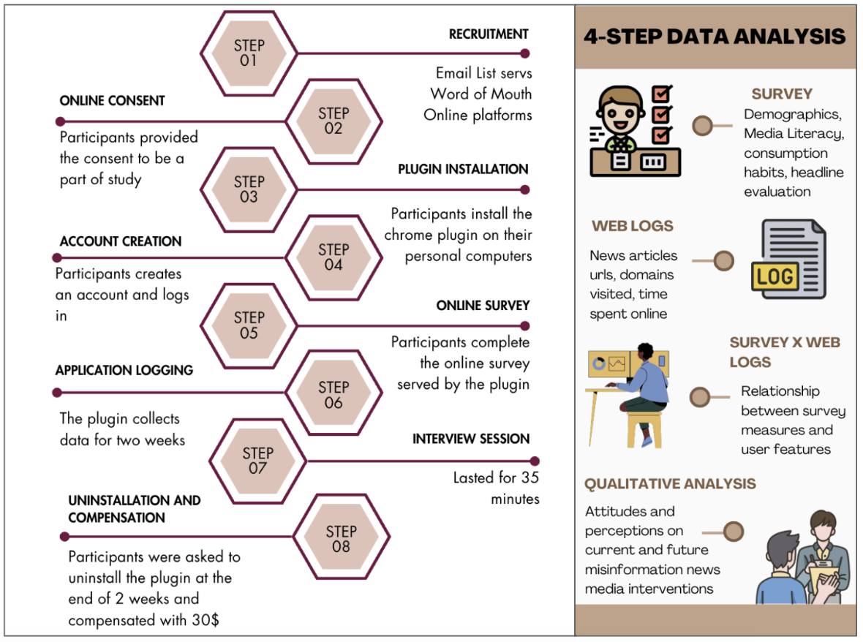
Contents
1.
Motivation and Background
2.
Research Questions
Methodology
4.
Key Findings
5.
Design Implications
6.
Insights, Limitations and Future Work
Notes:
let’s go over the methodology we applied in this study.
I’ll walk you through our mixed-methods approach — starting with the participant recruitment, then the survey and plugin data collection, and finally the follow-up interviews.”

Slide 13
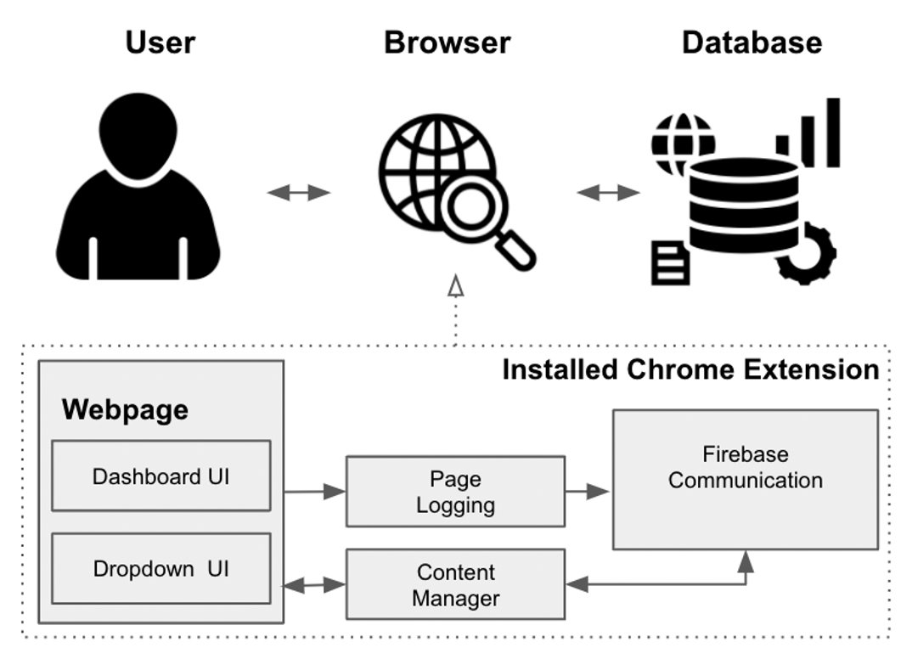
Architecture of
Chrome Plugin
The plugin follows a similar architecture to prior work such as OpenLabel, an open-source media labeling browser extension (VanTol et al., 2022).
Step 1
Chrome Plugin Setup: Users installed the unlisted Chrome extension, created an account, logged in, and completed a Qualtrics demographic survey.
Notes:
Let’s first talk about the Chrome plugin extension we developed to collect participants’ browsing data.
We built this tool using a client-server architecture. similar to prior work by Bentley et al. and VanTol et al.
The plugin worked on desktop Chrome browsers only and communicated with a Firebase backend to securely log data.
We made deliberate choices in design — for example, using email/password login instead of Google accounts to avoid linking personal profiles and to address privacy concerns.
“Participants installed the plugin from an unlisted Chrome Store link, created an account, logged in, and completed a short Qualtrics demographic survey shown on the splash screen.
The extension was installed only on their personal computers — not on mobile browsers — to maintain a consistent data-collection environment.”

Slide 14
Architecture of
Chrome Plugin
The plugin follows a similar architecture to prior work such as OpenLabel, an open-source media labeling browser extension (VanTol et al., 2022).
Step 1
Chrome Plugin Setup: Users installed the unlisted Chrome extension, created an account, logged in, and completed a Qualtrics demographic survey.
Step 2
Data Collection: The plugin recorded domain-level metadata, article URLs (for 513 news domains), article bias, timestamps, and active time spent on pages — without tracking non-news activity.
Notes:
Once installed, the plugin recorded domain-level metadata such as the website name, along with article URLs for 513 known news domains, their bias ratings, timestamps, and the time spent on each page.
It’s important to note that the plugin did not capture any activity within non-news sites — for example, it would log that someone visited Facebook.com but not what they did there.
This selective approach helped minimize privacy risks while still providing insight into news-related browsing.”

Slide 15
Architecture of
Chrome Plugin
The plugin follows a similar architecture to prior work such as OpenLabel, an open-source media labeling browser extension (VanTol et al., 2022).
Step 1
Chrome Plugin Setup: Users installed the unlisted Chrome extension, created an account, logged in, and completed a Qualtrics demographic survey.
Step 2
Data Collection: The plugin recorded domain-level metadata, article URLs (for 513 news domains), article bias, timestamps, and active time spent on pages — without tracking non-news activity.
Step 3
Engagement Tracking: Tab-switch and focus-based tracking captured real-time active browsing (clicks, scrolling, multimedia interaction) while excluding inactive periods.
Notes:
To understand real-time engagement, the plugin tracked tab-switching events and focus changes, allowing us to determine when a participant was actively reading a news article.
It also recorded active browsing actions like scrolling, clicking, watching embedded media, or filling out forms — while excluding inactive periods such as when a tab was open but unattended.
This gave us a more accurate measure of time-on-task for news consumption.”

Slide 16
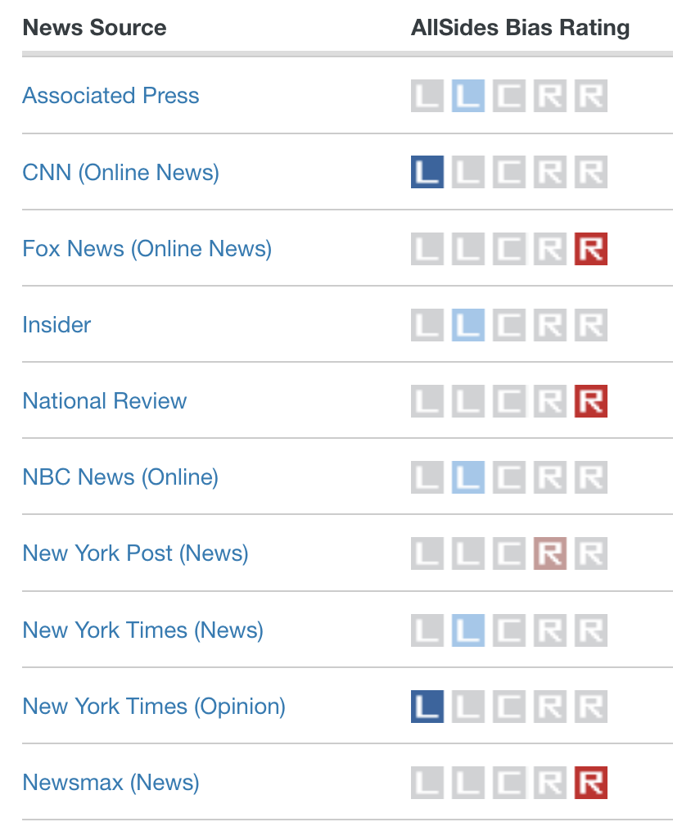
All Sides Dataset
The AllSides Dataset is a collection of prominent media outlets labeled for political bias, containing data on the source, article content, and bias rating assigned by the AllSides team.
Notes:
We used the AllSides dataset to identify and curate the list of news domains to be tracked, allowing our tool to accurately capture participants’ visits to these news sites.”

Slide 17
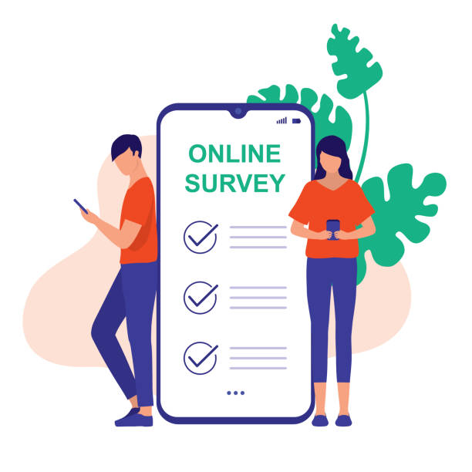

Study Approach-
Mixed Method
Pre-Survey and
logging browsing session
1
Quantitative Research
Key findings
3
Triangulation
2
Follow-up Semi-structured Interviews.
Qualitative Research
‹#›
Notes:
We followed a mixed-methods approach, triangulating three sources of data — a pre-survey, two weeks of logged browsing sessions using our Chrome plugin, and follow-up semi-structured interviews.
This approach was inspired by prior research showing that mixed methods are especially effective in studying misinformation because they reveal both broader trends and the underlying mechanisms behind user behaviors.
In our case, the survey captured media-literacy levels and demographics, the logging provided granular, real-time data about how participants actually engaged with online news, and the interviews added qualitative depth to explain the motivations and perceptions behind those patterns.
By comparing the logged behaviors with the self-reported survey and interview data, we were able to identify discrepancies between what participants thought they were doing and what they were actually doing — which is key for designing more targeted interventions.”

Slide 18
Step 1
Step 2
Step 3
Step 4
Pre-Survey and
logging browsing session
1
Quantitative Research
Key findings
3
Triangulation
2
Age: 18+ years
Residency: U.S. citizens or permanent residents
Language: Proficient in English (reading & writing)
Browser: Use Chrome on a desktop computer for news reading
Follow-up Semi-structured Interviews.
Qualitative Research
Recruitment & Consent: Participants were recruited via email/online and provided consent.
Setup: They created an account and installed a Chrome plugin.
Data Collection: The plugin logged browsing behavior for 2 weeks.
Follow-up: Participants completed a short survey + 35-min interview
Finally, they uninstalled the plugin and received $30.
This study protocol was approved by our university’s Institutional Review Board (IRB Protocol #1871618-2).
Notes:
Click click

Slide 19
Pre-Survey on Media Literacy & Demographics
1
2
3
4
Participation was solicited via an email listserv, and access to the survey was provided through the dropdown in the tool.
(i) a headline evaluation task, (ii) a self-report about news consumption habits, (iii) a news media literacy evaluation, (iv) information literacy evaluation, and (v) basic demographic information
Participants were given ten headlines, some true and some false, and asked to identify which were fake or real.
News Media Literacy was assessed with seven Likert-scale items, and Information Literacy was measured using multiple-choice questions with one correct and three incorrect options.
Notes:
We have a pre survey on media literacy and demographic
The survey contains headline evaluation tasks, media literacy assessment using standrized scales from prior literacrytre and demographics collection

Slide 20
Contents
1.
Motivation and Background
2.
Research Questions
3.
Methodology
Key Findings
5.
Design Implications
6.
Insights, Limitations and Future Work

Slide 21
Findings | Survey
1
Sample Profile
34 participants (median age = 27, majority female and democrats, diverse racial/educational backgrounds).
2
News habits
Most read news online daily, but mainly from a narrow set of mainstream/liberal outlets (NYT, CNN, Washington Post, BBC, etc.).
3
Media Literacy
High news media literacy (M = 0.83), but relatively low information literacy (M = 0.58).
4
Headline Judgements
True headlines rated more accurate than false (0.58 vs. 0.43), but sharing intentions were similar for both (≈0.22).
5
Discernment
Positive for accuracy ratings (DI_acc = 0.15) but slightly negative for sharing (DI_dis = –0.01), showing a gap between recognizing accuracy and deciding what to share.
DI_acc (Accuracy Discernment Index): A measure of how accurately participants can distinguish between true and false headlines. It reflects the ability to correctly identify the veracity of information.
DI_dis (Sharing Discernment Index): A measure of how selectively participants choose to share headlines based on their accuracy. It reflects whether people are more likely to share true headlines while withholding false ones.
Notes:
• First, we had 34 participants, median age 27 — most were female, leaned Democrat,
• Second, most participants read news online daily, but their habits were concentrated on a narrow set of mainstream or liberal outlets like NYT, CNN, Washington Post, and BBC.
• Third, they scored high on news media literacy (mean score 0.83) but had lower information literacy overall (mean score 0.58).
• Next, when judging headlines, they rated true headlines as more accurate than false ones — but their intentions to share were about the same for both.
• Finally, we saw a gap between recognizing accuracy and deciding what to share: participants could identify accurate headlines but didn’t necessarily avoid sharing false ones.
This tells us that knowing what’s true doesn’t always translate into cautious sharing behavior.”

Slide 22
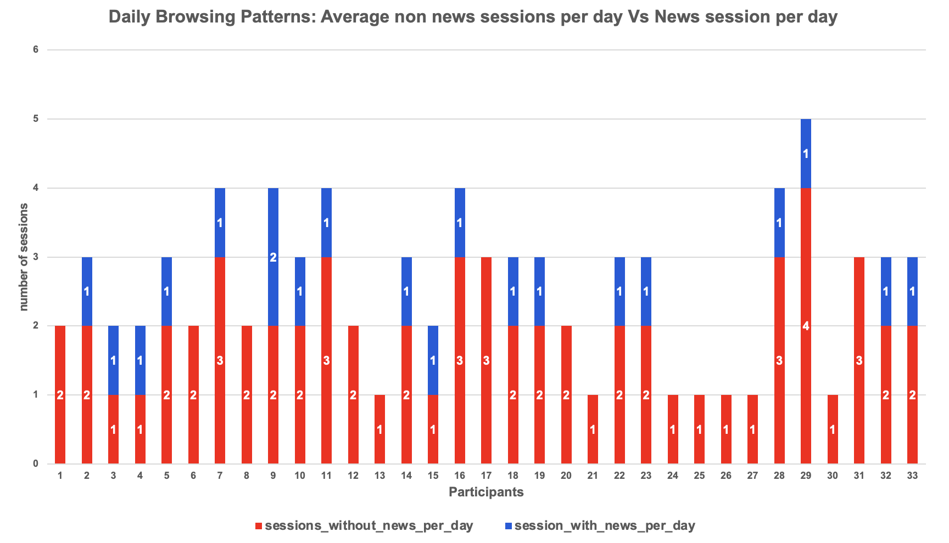
Findings | Browsing Log
Avg. 2 hrs/day active browsing (SD = 1.43).
~2 non-news sessions & 1 news session/day.
20/34 participants engaged with news; 14 did not.
News bias: Most participants reading skewed left-center:
44.42% → Left-Center, 9.09% → Center, 6.06% → Left, 3.03% → Right
Notes:
Click
People browsed about 2 hrs/day.
Usually 2 non-news and 1 news session/day.
20 of 34 read news; 14 didn’t.
News mostly left-center: 44% left-center, 9% center, 6% left, 3% right.
most were light news readers, and their sources leaned left-center.

Slide 23
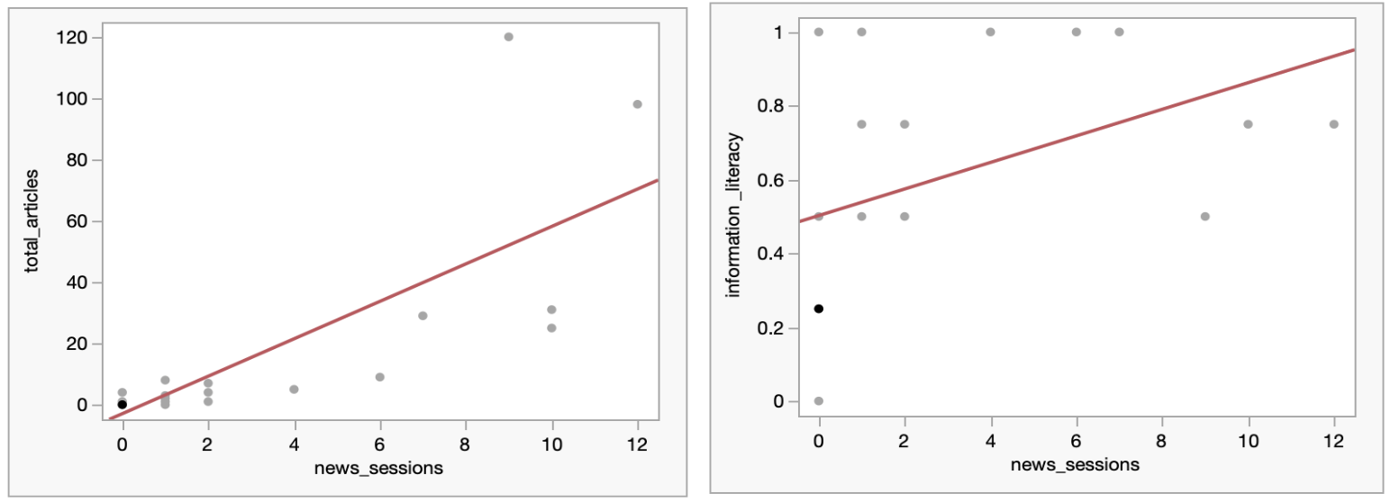
Browsing Data X Survey Results
Articles read and News session
Information literacy and News session
(𝑅2 = 0.16, f(1, 31) = 5.98, p = 0.02*)
(𝑅2 = 0.63, f(1, 31) = 51.84, p <.0001*.)
Notes:
After merging logs with surveys, we saw: more news sessions → more articles read.
In our sample, there’s a moderate positive link (r = 0.4) between news sessions and information-literacy scores.

Slide 24
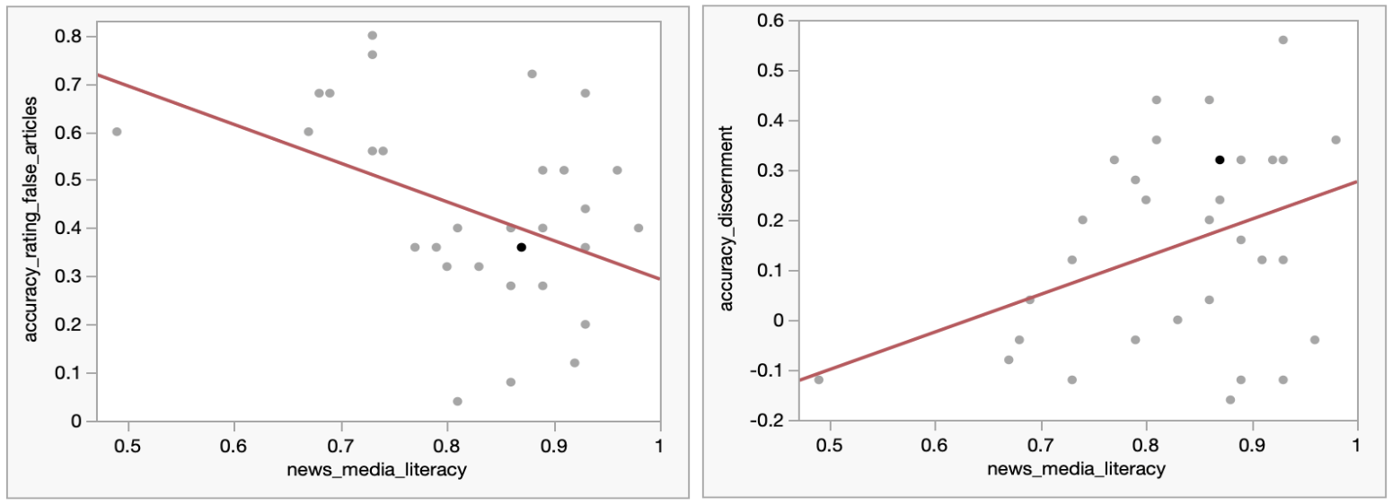
Browsing Data X Survey Results
News media literacy Vs. Accuracy rating of false article
News Media Literacy Vs. Accuracy Discernment
(𝑅2 = 0.15, f(1, 31) = 5.6, p = 0.0245*)
(𝑅2 = 0.18, f(1, 31) = 7.17, p = 0.0117*)
Notes:
Participants with
higher news media literacy scores tend to assign lower accuracy ratings to false articles
they are also better
at determining the accuracy of headlines

Slide 25
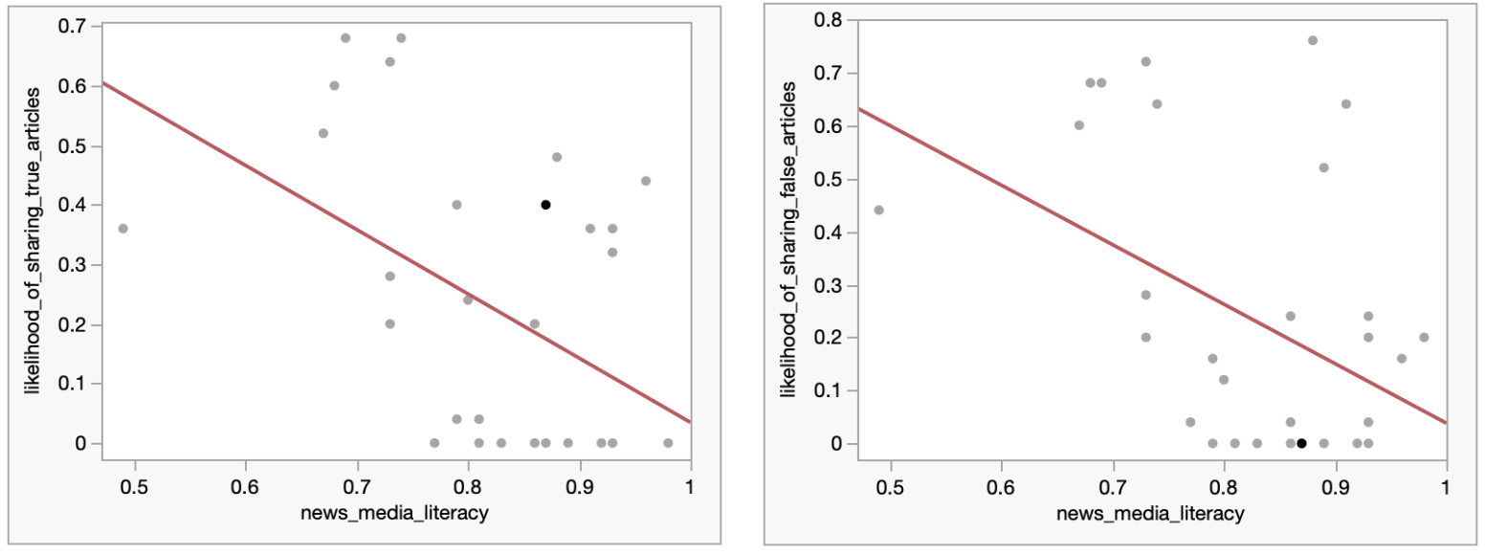
Browsing Data X Survey Results
News media literacy Vs Likelihood of sharing (True article)
News Media Literacy Vs Likelihood of sharing (False article)
(𝑅2 = 0.19, f(1, 31) = 7.4, p = 0.0020*)
(𝑅2 = 0.22, f(1, 31) = 8.9, p = 0.0054*)
Notes:
The graph on the left looks at sharing true articles — as news media literacy increases, the likelihood of sharing even true articles goes down slightly.
The graph on the right shows the same trend for false articles — participants with higher news media literacy were significantly less likely to share false or misleading headlines.
Overall, both graphs show a negative trend line — meaning that people who scored higher on literacy were more cautious about sharing news, especially false articles.

Slide 26
Lateral Reading: Browsing Behavior vs. Survey Responses
03
Literacy scores
Lateral readers scored significantly higher in both news media literacy (0.87 vs. 0.79; p = .038) and information literacy (0.70 vs. 0.47; p = .029), with medium-to-strong effect sizes.
Time Spent Online
Lateral readers browsed slightly longer daily (2.2 hrs vs. 1.7 hrs), but this difference was not statistically significant.
01
02
News Sessions
Lateral readers had significantly more news-reading sessions per day (M = 4 vs. 1; p = .009, medium effect).
Notes:
One of our research questions asked whether participants actually practice lateral reading—that is, checking other news sites to verify a story.
We found that 16 out of 34 participants — about 47% — showed evidence of lateral reading.
We identified this by looking at their browsing patterns: for example, visits to similar-topic articles on different sites within five minutes of each other.
Interestingly, lateral readers tended to have higher news-media-literacy scores and more engaged news habits, even though they didn’t necessarily spend more total time browsing.
It means it’s not just how long people read, but how they navigate across sources that matters for literacy and discernment.”

Slide 27
Interaction with misinformation
Users in our study tended to visit a relatively small number of domains, with 84 unique domains visited among the other studies datasets and 50 unique domains from our dataset. Of these domains, the vast majority, 79 out of 84, were labeled as "reliable," while only five were labeled as "unreliable."
174 Domains
339
4428 Domains
All Sides Dataset Alternate Dataset (Hause et al.)
Notes:
“We also looked at the reliability of the news publishers our participants visited.
To do this, we cross-checked our browsing logs with a dataset by Hause et al. that rates publisher reliability.
Out of the 84 unique domains visited, only 5 were labeled ‘unreliable,’ while 79 were rated ‘reliable.’
This shows that most participants were browsing credible outlets and had limited exposure to unreliable publishers known for spreading misinformation.
These findings align with previous research by Guess et al., suggesting that active news consumers often stick to reputable sources.”

Slide 28

Findings: Qualitative Impression
Interviews: Subset of participants (n = 15) invited via email
Topics: Fake news, platform perceptions, tool familiarity, attitudes toward interventions
Duration: ~35 minutes on average (SD ≈ 11.8)
Most participants (14/15) reported a daily habit of reading online news, averaging about 45 minutes per day — but their self-reported time often differed from observed patterns due to multitasking and switching tabs.
Nearly half (7/15) found it challenging to track their actual reading time across different platforms (websites, apps, social media).
“I often struggle to figure out how much time I spend reading articles because I’m quite meticulous about fact-checking… I might go to CNN, Fox, or PBS to see how each covers the story, so it’s tricky to nail down exactly how long I’m on each article.” — P17
Notes:
"These findings come specifically from the debrief interviews.“I want to highlight that, during this stage, we were intentionally probing participants about the future tool and their perceptions of its design.”
The goal was to gather their reflections not just on the news content itself, but also on how the intervention features shaped their experience, usability, and discernment.
Behavioral mismatch: Users multitask, skim read, frequently tab-switch–misjudging reading time. Exposure is mistaken for engagement.

Slide 29
Findings: Qualitative Impression
Nearly half (7/15) agreed that sentiment analysis could be helpful, provided the analysis was trustworthy.
"I think knowing the sentiment will also be useful. But then, again, it depends on who’s evaluating the emotion. Is it AI? Is it a human being? Because there’s a lot of difference between a human being doing that and AI, and if it’s AI doing it, I think we need to improve it through machine learning, but I think it would be” (P45).
Notes:
User Perceptions of Intervention:
Helpful: Content warnings, Fact-check prompts, Exposure to diverse perspectives
Concerns: Constant monitoring, Biased AI moderation, Intrusive “nudges”
Desired tools: Personal informatics dashboards, Transparent recommendation systems, Cross-source credibility checkers

Slide 30

Findings: Qualitative Impression
One-third (5/15) were negative and hesitant about the idea of the tool constantly monitoring their browsing behaviors and saw more risks than benefits from this kind of data collection.
"I rarely install plugins unless I believe they are crucial because I am generally wary about data collection. If it monitors my browsing behavior, looks at my news, and gives me feedback, I will not download it. It would be insulting to me personally, and it would also be quite dangerous for many other people.” (P30)
Notes:
User Perceptions of Intervention:
Helpful: Content warnings, Fact-check prompts, Exposure to diverse perspectives
Concerns: Constant monitoring, Biased AI moderation, Intrusive “nudges”
Desired tools: Personal informatics dashboards, Transparent recommendation systems, Cross-source credibility checkers

Slide 31

Findings: Qualitative Impression
Most participants showed mixed reactions toward the tool’s data collection: 7/15 were neutral, wanting clarity on privacy policies and data protection before use.
2/15 were positive, seeing benefits in accurate information about news publishers and willing to share data if they gained value in return.
“I am comfortable using such tools if they provide me with good articles… but they should give me something in return.” — P23
Notes:
User Perceptions of Intervention:
Helpful: Content warnings, Fact-check prompts, Exposure to diverse perspectives
Concerns: Constant monitoring, Biased AI moderation, Intrusive “nudges”
Desired tools: Personal informatics dashboards, Transparent recommendation systems, Cross-source credibility checkers

Slide 32
Findings: Qualitative Impression
Participants expressed interest in a personal informatics dashboard to help them reflect on their online activity and behavioral change
It would be excellent to have a feature that allows users to view their activity during the past week, reflect on what they did, and determine whether it has changed their behavior. I’d like to see everyone have access to as much information as possible about the safety, efficacy, and costs of drugs, vaccines, devices, and medical services, particularly regarding health care. Those who think the content warning is part of a conspiracy would not use it. (P44)
Notes:
User Perceptions of Intervention:
Helpful: Content warnings, Fact-check prompts, Exposure to diverse perspectives
Concerns: Constant monitoring, Biased AI moderation, Intrusive “nudges”
Desired tools: Personal informatics dashboards, Transparent recommendation systems, Cross-source credibility checkers

Slide 33
Contents
1.
Motivation and Background
2.
Research Questions
3.
Methodology
4.
Key Findings
Design Implications
6.
Insights, Limitations and Future Work
Notes:
• Finally, drawing on our insights, we presented design recommendations for application developers to build future credibility-evaluation tools that are transparent, user-centered, and supportive of everyday critical news engagement.

Slide 34
Design Implications
In-Situ Content Warnings
Highlight biased or emotionally charged text directly in articles to promote awareness, avoiding disruptive pop-ups or over-used warnings.
Non-Intrusive & Transparent Practices
Build trust through clear permissions, gradual onboarding, customizable settings, and strong privacy controls.
Reflective Prompts & Nudges
Use brief reminders, weekly summaries, and adaptive prompts to expose users to diverse perspectives without overwhelming them.
Optimized Media-Literacy Tools
Offer personalized challenges, visual progress trackers, and tutorials for vulnerable groups to strengthen critical evaluation skills.
Lateral Reading Support
Integrate links and cues within articles to encourage credibility checks and provide guidance for users with lower digital literacy.
Personal Informatics for Browsing
Track reading time, article counts, and source bias; show dashboards or playful feedback to help users reflect and diversify their news habits.
Notes:
“People often misjudge how much news they read. We suggest adding personal informatics—like showing reading time, number of articles, or the leaning of sources.
These simple dashboards or even playful prompts can help people reflect on their habits and make more balanced choices.”
“Lateral reading—checking other sites to verify a story—is a strong skill but not everyone uses it well.
Tools could add quick links to related coverage or credibility checks right inside articles, helping those with lower digital literacy see alternative perspectives without extra effort.”
“We can go beyond just showing news to offering personalized challenges or feedback that help users practice spotting misleading headlines.
Progress trackers or small visual cues can show how their skills improve over time and give special support to users with lower literacy.”
“Many people say they want diverse viewpoints but end up in echo chambers.
We propose lightweight nudges—like a brief weekly summary or a reminder to check accuracy—to spark self-reflection without interrupting their browsing.”
“Trust matters. We learned that users want clear privacy explanations and control over how often tools prompt them.
Starting with gentle nudges and letting them adjust frequency or type of alerts can help build confidence and adoption.”
“Instead of heavy pop-ups, users preferred subtle in-article highlights—for example, flagging emotionally charged or biased language right where it appears. This draws attention to questionable sections without feeling disruptive or overwhelming.”

Slide 35
Wrapping Up: Key Insights & Limitations
Logged behavior reveals gaps between perceived vs. actual news habits.
Media literacy & lateral reading linked to stronger engagement and misinformation detection.
Participants are quite adept at evaluating news credibility/bias, but weaker in broader search strategies.
Participants generally showed a basic awareness of defense mechanisms against misinformation, consuming news primarily from reliable outlets
Limitations:
Pilot study with small, skewed sample (educated, liberal-leaning women), dataset bias
Limited to Desktop Users
Mobile behaviors not captured
Allsides Data Reliance
Notes:
In this study we …logged bhevaiour.
First, we observed a positive linear trend — participants with higher news-media-literacy scores tended to have a greater percentage of news-browsing sessions and spent more time online daily.
We also found that frequent news browsing was linked to a lower likelihood of sharing misleading or inaccurate headlines, suggesting that more engaged readers might be more discerning.
Participants generally showed a basic awareness of defense mechanisms against misinformation; many reported consuming news primarily from more reliable outlets, which reflects a level of news-media literacy. However, even though many said they wanted to seek diverse viewpoints, they often gravitated toward sources that aligned with their political beliefs — showing a gap between intention and behavior.
Participants expressed a strong preference for non-invasive, transparent interventions, highlighting the importance of designing tools that respect user agency and privacy.
Divergence was there
• First, this was a pilot exploratory study with a small and skewed sample — mostly highly educated, liberal women who were active news consumers. So, the results aren’t fully generalizable.
• Second, the data came only from the Chrome extension on participants’ personal computers — we couldn’t capture browsing on phones or work devices.
• Third, the AllSides dataset we used may not cover every news source and could itself have bias in how it rates outlets.
Despite these limitations, the study still highlights key trends — like the gap between reported and observed habits and the role of literacy in headline discernment. Future work should test these findings on larger and more diverse populations.”

Slide 36

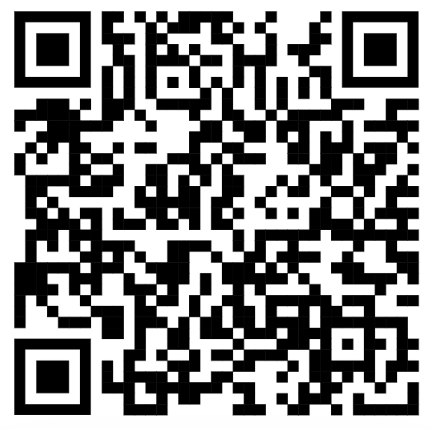






Thank you
Questions! Let’s discuss.
Or, let’s chat later. Contact me at: preranak@udel.edu
Full paper → Scan here
Find me on Linkedin
Prerana Khatiwada
Luke Halko
Nabiha Syed
Aneseh Alvanpour
Ashrey Mahesh
Dr. Matthew Mauriello

